Slide 1



SOFTWARE DEVELOPMENT PROFESSIONAL PROGRAM
Server-Side Views & Rendering with JSX

Slide 2





Server-Side Views & Rendering with JSX
Learning Objectives
Add views to the app.
Learn basic JSX to create views.
Build an index view.

Slide 3

Server-Side Views & Rendering with JSX
BreadCRUD
We will continue to build BreadCRUD.
Today's user story:
Anyone will be able to read an index of all the breads.
Notes:
Breaking down the project into small, testable pieces is often new for learners.

Slide 4
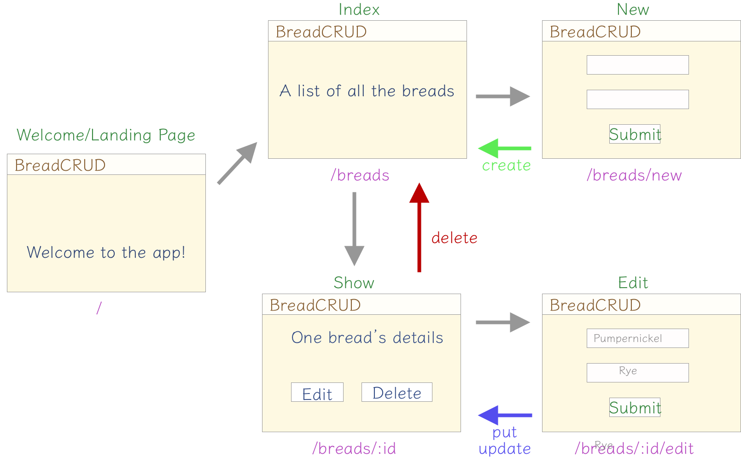
Server-Side Views & Rendering with JSX
BreadCRUD Views & Routes
null
Notes:
Take your time. This image will be reused/revisited later as learners build each route.

Slide 5
Server-Side Views & Rendering with JSX
Code-Along Demo
BreadCRUD Demo
BreadCRUD
Notes:
Review what learners will build. They often struggle to find their footing when first builing an app of this size.

